Slide 1
Community service
Code for Cause
Group: FYI We do Code!
AELINA DAS
ABHISHEK VISHWANATH

Slide 2
Contents
Introduction
Problem Statement
Solution
Approach
Use Cases
Designs
Workflows
Additional features

Slide 3
Introduction
There are organizations and volunteers around the world who are on a pursuit to serve underprivileged members of the society, in all possible ways.
Organizations like Food banks, kitchen soups, community churches etc. are striving to serve the needy at their best.
But only few organizations can afford to have system to manage their activities.
In this project we are trying to develop a system that allows different organizations to communicate and serve various communities in the best possible way.
Most importantly, tackle food insecurity with the collaboration of Health Care organizations.

Slide 4
Problem statement
Food pantries and food banks have vey limited effective communication due to lack of a sophisticated system
Food pantries rely on limited resources from government and local service agencies that makes difficult to maintain continuous supply to the pantry
Food pantries do not have any resources to connect to them to health care organizations to have health screening for their community
Food pantries stock shelf-stable food (including canned, boxed and other processed foods), they often struggle to meet the nutritional needs of their clients.
Food pantries rely on donations to stock their shelves – but often, those donations are low quality or culturally inappropriate

Slide 5
solution
We have designed a system that allows Food Banks, Hospitals, and Food Pantries to communicate effectively to monitor food insecurity and health issues in a community
In this system ,we have brought three different entities into the ecosystem model to establish hierarchy and leveraged workflows as a means for effective communication
Now, food pantries can communicate directly with doctors and nutritionists to put a check on the community health problems

Slide 6
Approach
Connected Food banks, Food Pantries and Hospitals all under a city network
Equipped each individual with a work area based on their role in the ecosystem
Established communication across organization and enterprise in the form of work requests

Slide 7
use cases
Order Grocery for Food Pantry from a Food Bank
Raise a Health Screening request with Health Care Organizations for their community
Raise a request with a Nutritionist, for guidance on serving the right food to the community
Keep track of meals served by the pantry on each day, to gain insights on economic standards of a community
Assess the health of a community

Slide 8
Architecture Diagram

Slide 9
Object MODEL

Slide 10
WORK REQUEST FLOW

Slide 11
FOOD Bank ADMINISTRATOR

Slide 12
FOOD Pantry ADMINISTRATOR

Slide 13
Food packer

Slide 14
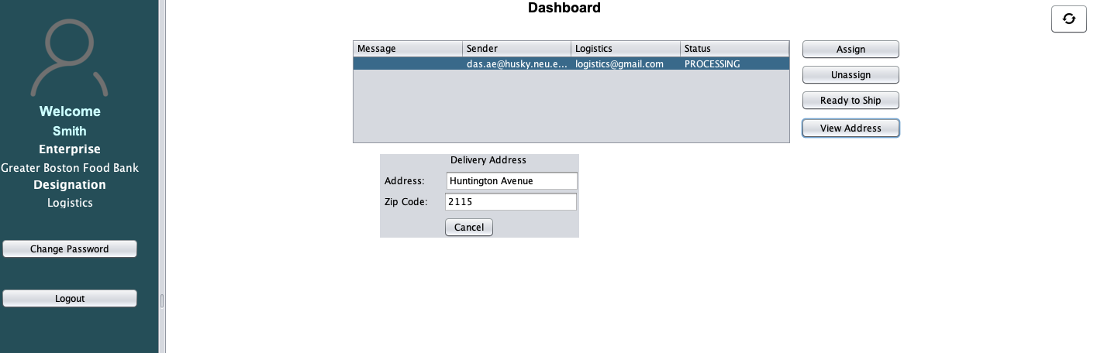
LOGISTICS

Slide 15
DOCTOR

Slide 16
LABAROTORY ASSISTANT

Slide 17
NUTRITIONIST

Slide 18

Additional features

Slide 19
Additional features

Slide 20
THANK YOU

